Slide 1

Analysis of Eniac’s Discount Strategy
Gracia Emerentiana [E-DA-55]

Slide 2
Eniac’s Debate
Improve customer acquisition, satisfaction and retention
Marketing Team Lead
Yes
allow the company to grow
Beneficial?
Discount Strategy
Hypothesis
increase in orders placed, but a decrease in the total revenue
No
Main Investors in the Board
Prefer the quality segment than competing to offer the lowest price

Slide 3
Discounts’ Analysis
about
Highest discount
96%
98%
Quantity-weighted
average discount
of Eniac’s products
are discounted
23%
discounted Brands
Time Period
94%
(175 of 187 Brands)
437 days

Slide 4
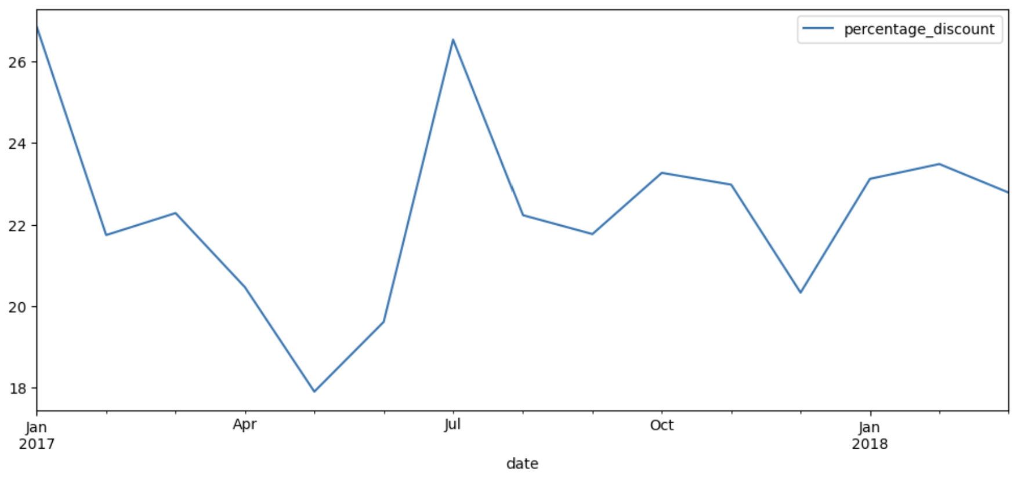
Average Monthly Discount

Slide 5
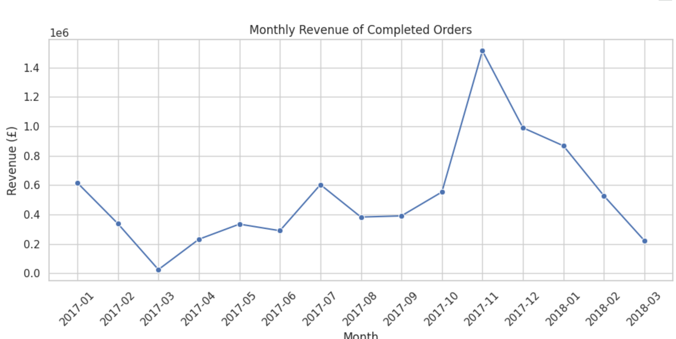
Monthly Revenue of completed Orders
Revenue fluctuates significantly throughout the year.
November 2017 generated the highest monthly revenue (£1.52 million).
December also performed strongly (£990k).
March 2018 had the lowest revenue.

Slide 6
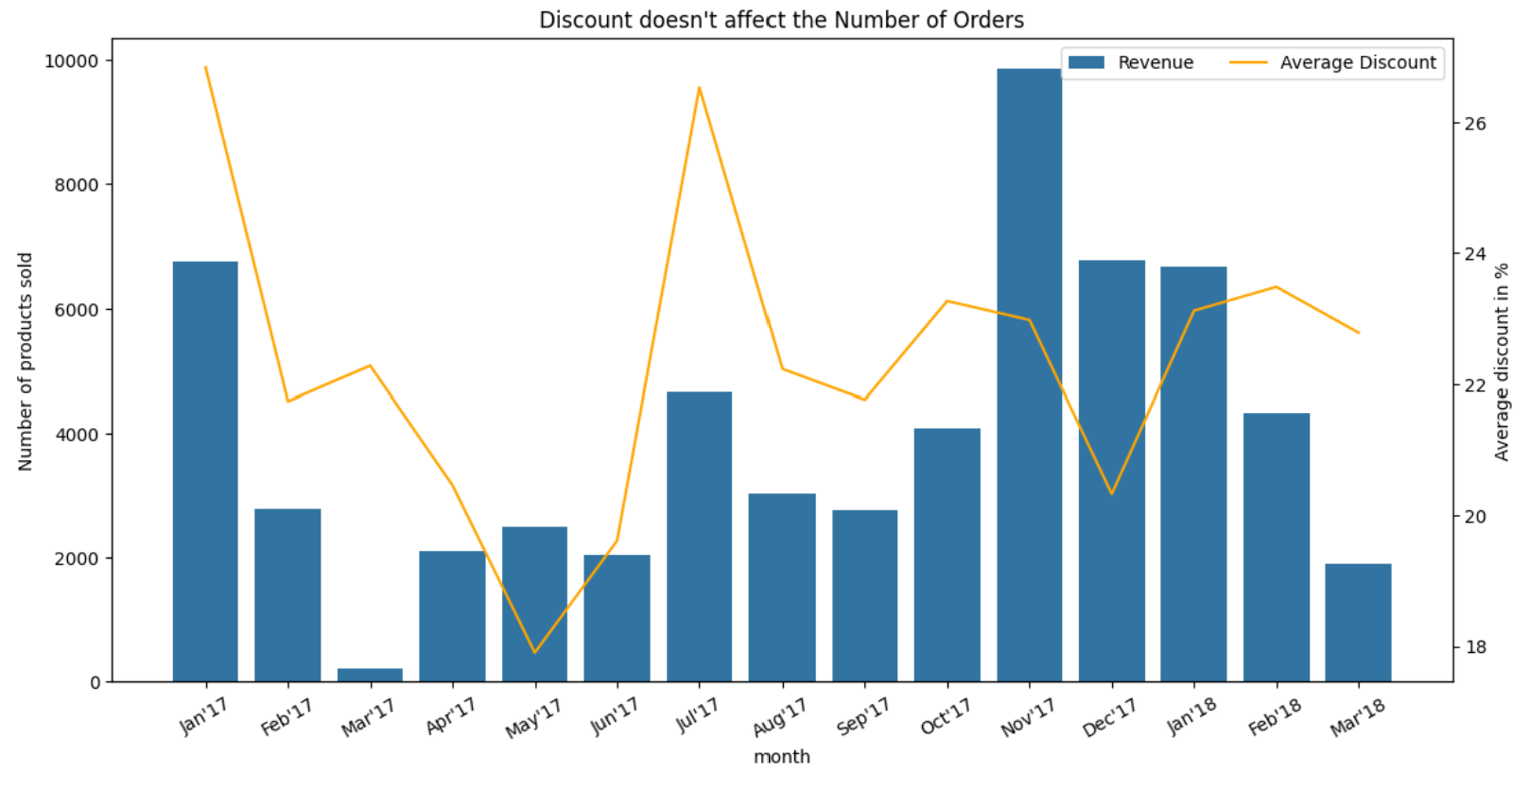

Slide 7
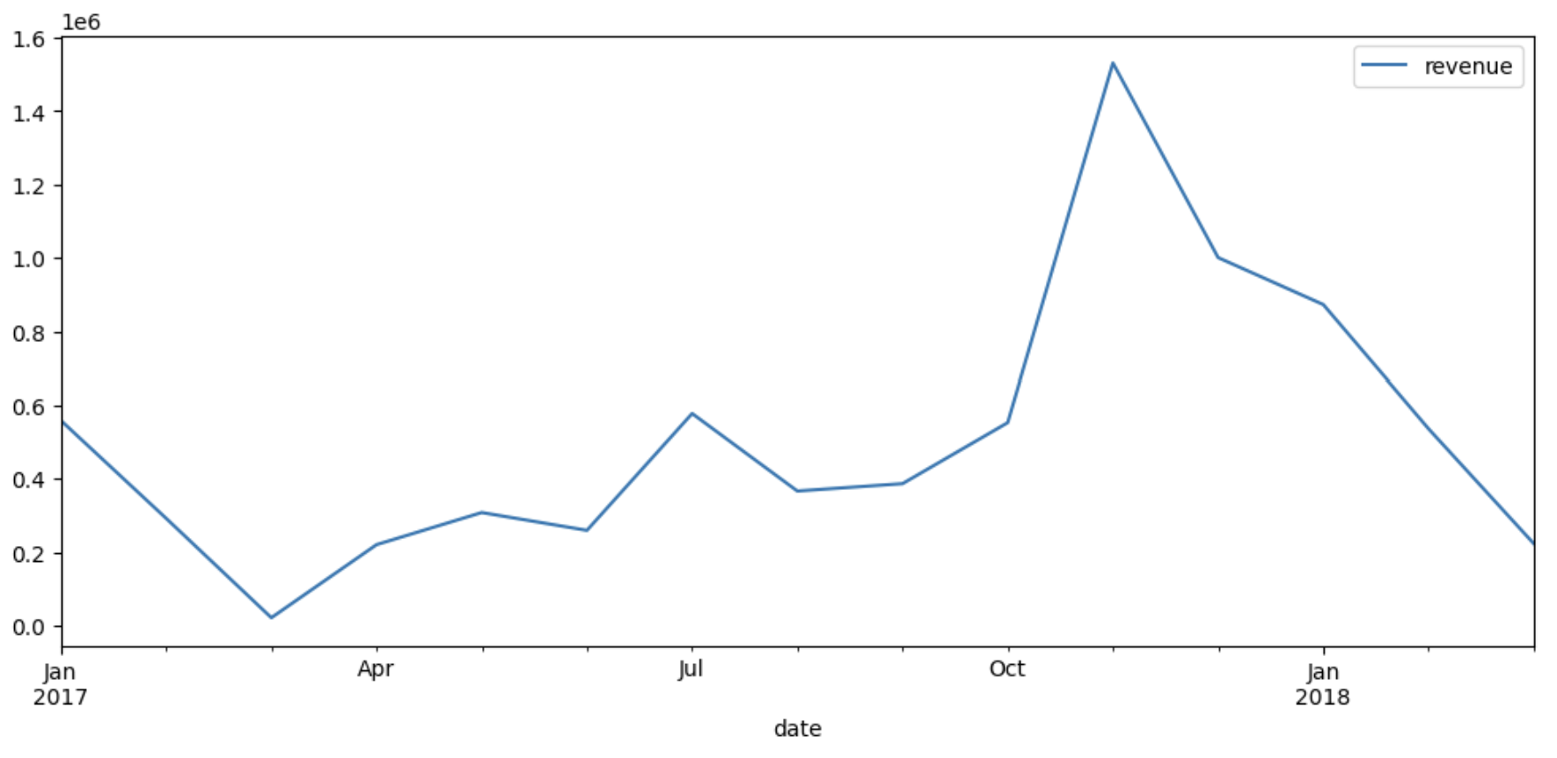
Monthly Revenue

Slide 8
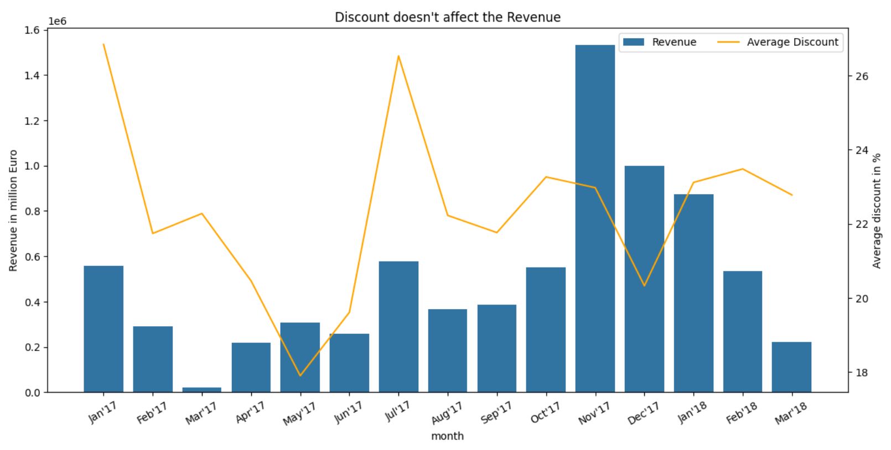

Slide 9
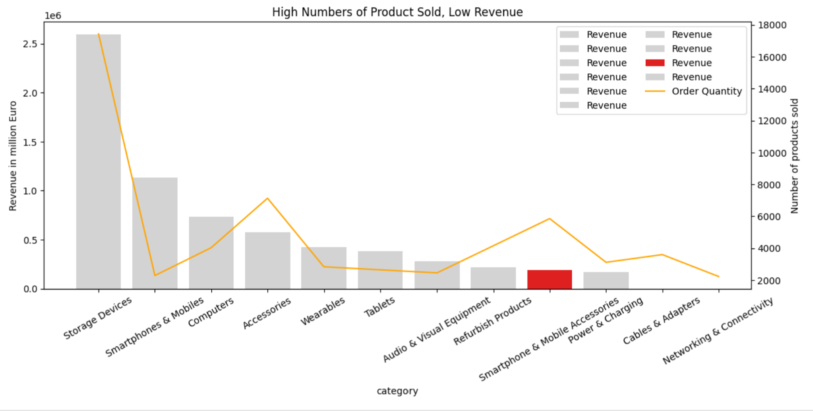
10 Most Sold Product Categories & Its Revenue

Slide 10
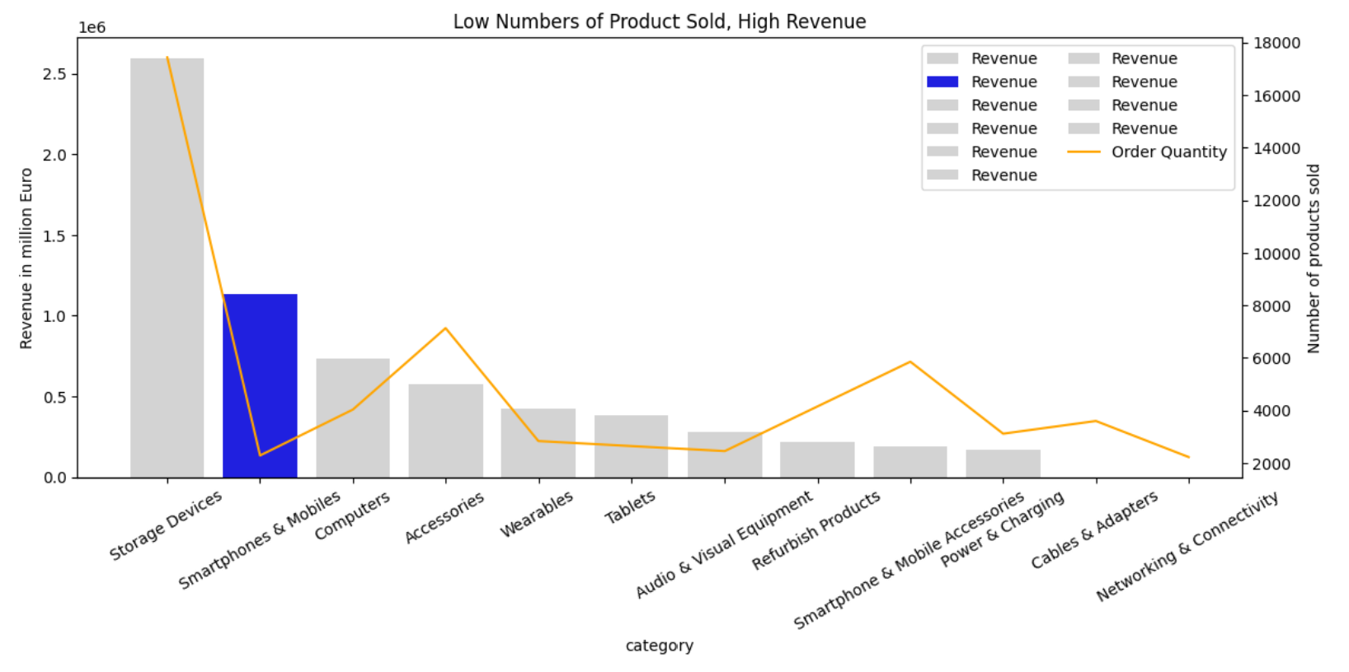
10 Most Sold Product Categories & Its Revenue

Slide 11
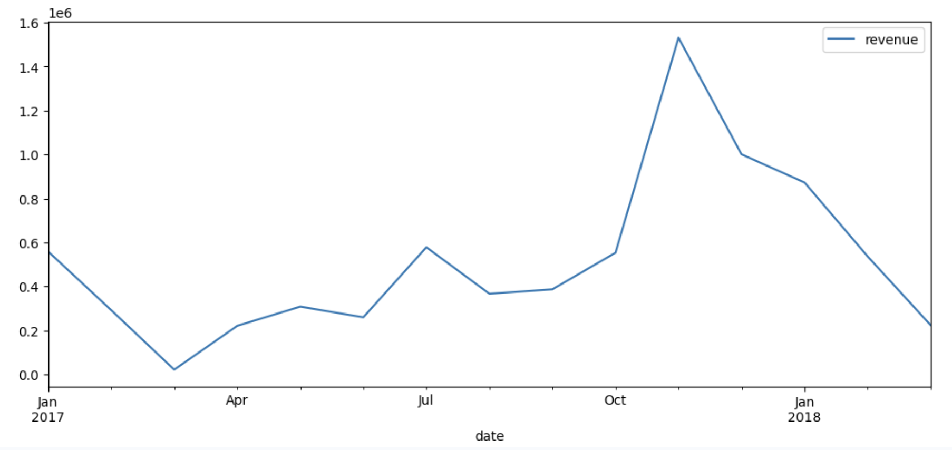
How do seasonality and special dates affect sales?

Slide 12
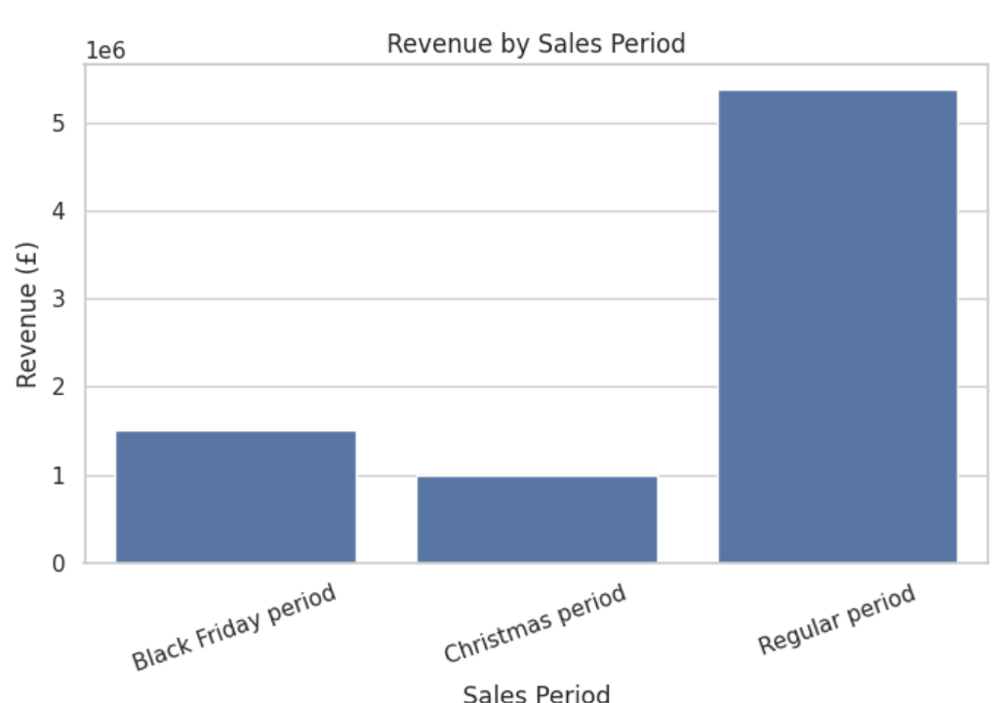
Total Revenue by Sales Period

Slide 13
Conclusion
Current Discount Strategy ≠ Beneficial
Discount Dependency
96% discounted products
not selective
Volume vs. Value
Orders ↑
Value (Revenue) ≠↑
Market Position
Risked long-term damage
Erosion of the brand’s quality-segment

Slide 14
Recommendation
Targeted Approach
Product differentiation:↑ Discount ↓ Price products ↑ Quantity
Sweet Spot Range (11-20%) discount rate 🡪 volume ↑, revenue ↑
Brand Protection
5% newsletter incentive for new users
Tiered Pricing
Spent 300 €, Save 15 €
Holiday Timing
Promotional efforts → highest conversion lift

Slide 15
For a better analysis
Data needed:
Revenue before the discount period
Customer satisfaction before and after the discount period
Delivery costs
Missing price data
Fix categories of products

Slide 16
Thank you
Question?

